Slide 1
Larger Networks
Subtitle

Slide 2

Network Hardware: Multiple Computers
Larger networks involve multiple computers with different operating systems

Slide 3



Network Hardware: Switches
Larger networks include multiple computers linked together by a device called a, “switch”
A switch acts as a connector between devices and reroutes incoming data to the correct destination

Slide 4
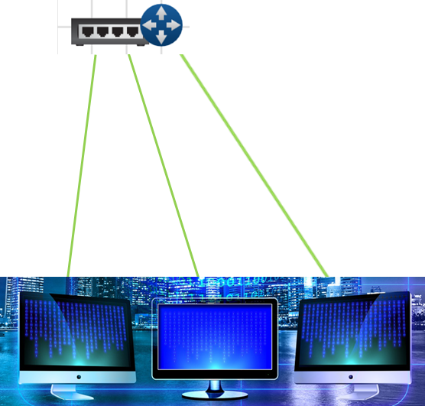
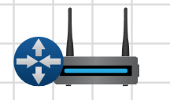
Network Hardware: Wifi Router
A wifi router or wireless router allows for your devices to connect to wifi, meaning your wireless devices can link to the wifi router through waves and communicate with outside networks

Slide 5

Network Hardware: Server
Large networks also have servers, or any device that can provide data or other resources to other devices
There are different types of servers including:
File servers
Email servers
Web servers
Web servers store webpages and shows them through web browsers

Slide 6
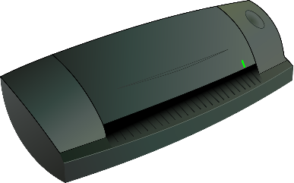
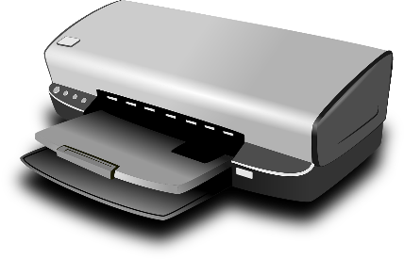

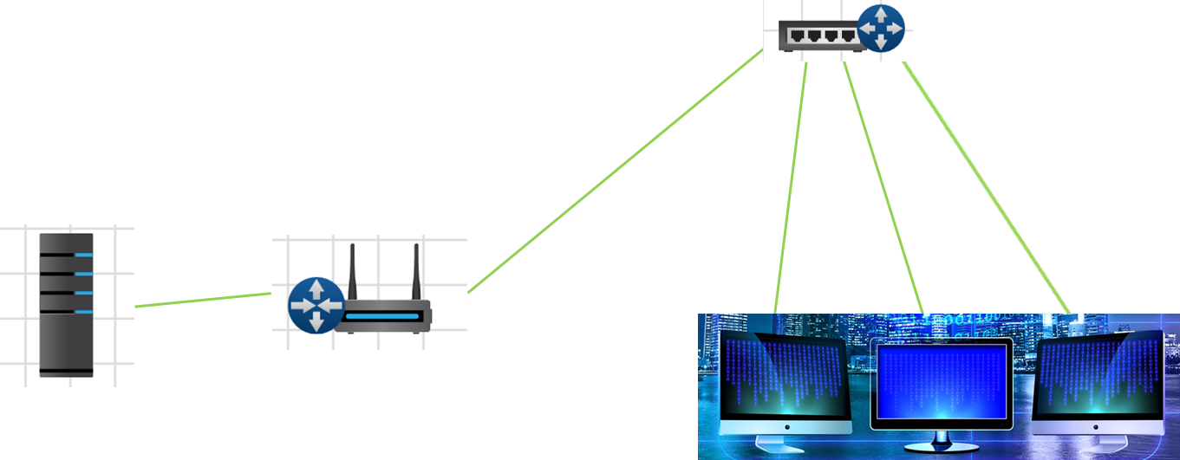
Network Hardware: Misc Devices
Like smaller networks, larger networks can include other devices such as:
Printers
Cell phones
Scanners
All of which are connected to the network through wired or wireless connection

Slide 7

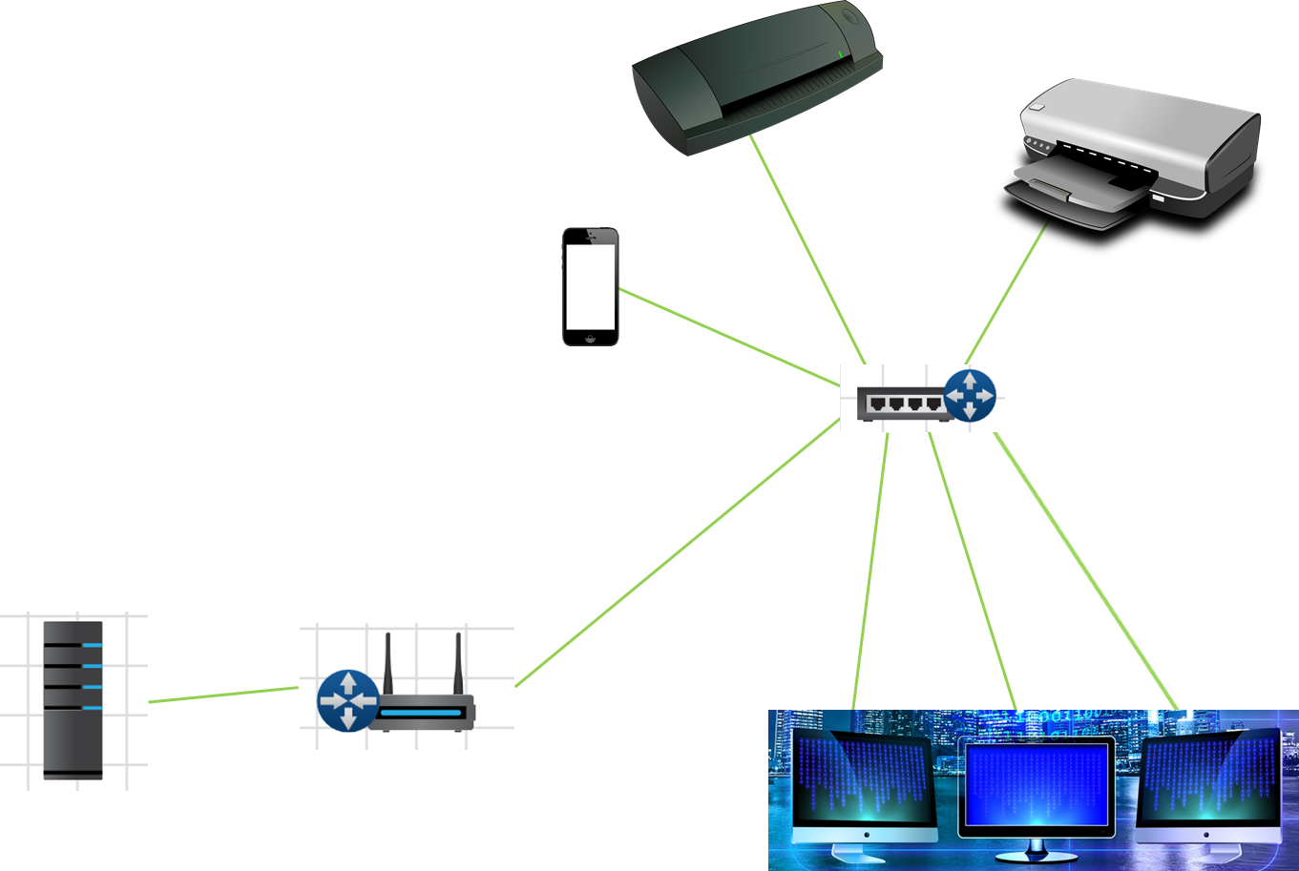

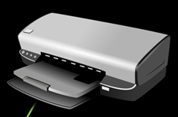


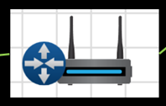

Advanced Network Game: Puzzle
Build a Network with the given parts:

